Slide 1

Actor-Critic for Continuing Tasks
Notes:
1

Slide 2
Objectives
Derive a sample-based estimate for the gradient
Understand the Actor-Critic algorithm
Actor-Critic for Continuing Tasks
2
Notes:
2

Slide 3
Estimating the Policy Gradient
Definition:
Estimating the policy gradient is a crucial step in policy gradient algorithms
It allows us to update the policy parameters in the direction that maximizes the expected return.
Actor-Critic for Continuing Tasks
3
Notes:
3

Slide 4
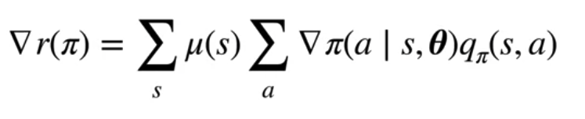
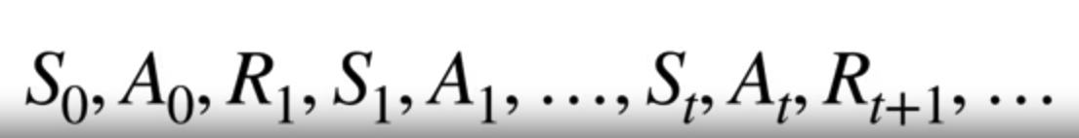
Estimating the Policy Gradient
The gradient of the average reward:
We simply make updates from states we observe while following policy pi.
Actor-Critic for Continuing Tasks
4
Notes:
4

Slide 5
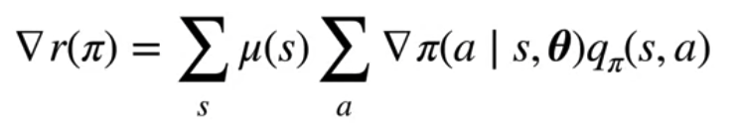
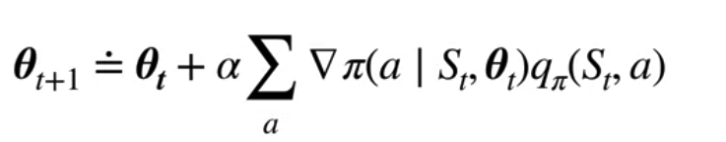

Estimating the Policy Gradient
This gradient from state St provides an approximation to the gradient of the average reward.
The stochastic gradient descent update looks like for the policy parameters
Actor-Critic for Continuing Tasks
5
Notes:
5

Slide 6
Estimating the Policy Gradient
Estimating the policy gradient methods
Finite Difference Methods: These methods approximate the gradient by perturbing the policy parameters and observing the change in the expected return.
Score Function Methods: Score function methods, directly estimate the gradient of the expected return using samples obtained from interactions with the environment.
Actor-Critic for Continuing Tasks
6
Notes:
6

Slide 7
Estimating the Policy Gradient
Estimating the policy gradient methods
Likelihood Ratio Methods: Likelihood ratio methods, further improve the efficiency of gradient estimation by subtracting a baseline function from the returns before computing the gradient.
Actor-Critic Methods: Actor-critic methods combine policy gradient estimation with value function estimation.
Actor-Critic for Continuing Tasks
7
Notes:
7

Slide 8
Estimating the Policy Gradient
Estimating the policy gradient methods
Natural Policy Gradient: Natural policy gradient methods incorporate the geometry of the parameter space into gradient estimation to improve convergence properties and stability.
Actor-Critic for Continuing Tasks
8
Notes:
8

Slide 9
Actor-Critic Algorithm
The Actor-Critic algorithm combines elements of both value-based and policy-based methods.
It consists of two main components: the actor and the critic:
Actor: The actor is responsible for learning the policy
Critic: The critic is responsible for evaluating the policy.
The Actor-Critic algorithm operates by iteratively updating the actor and critic networks based on observed experiences in the environment.
Actor-Critic for Continuing Tasks
9
Notes:
9

Slide 10
Actor-Critic Algorithm
Actor- Critic Algorithm:
Step 1- Initialization: Initialize the actor and critic networks with random parameters.
Step 2- Interact with Environment: Sample trajectories by following the current policy in the environment.
Step 3- Compute Returns: Compute the returns for each time step in the trajectory.
Step 4- Update Critic: Use the returns to update the parameters of the critic network
Actor-Critic for Continuing Tasks
10
Notes:
10

Slide 11
Actor-Critic Algorithm
Actor- Critic Algorithm:
Step 5- Compute Advantages: Compute advantages for each time step by subtracting the estimated value from the observed return.
Step 6- Update Actor: Update the parameters of the actor network using policy gradients
Step 7- Repeat: Repeat steps 2-6 for multiple episodes or until convergence criteria are met.
Actor-Critic for Continuing Tasks
11
Notes:
11

Slide 12
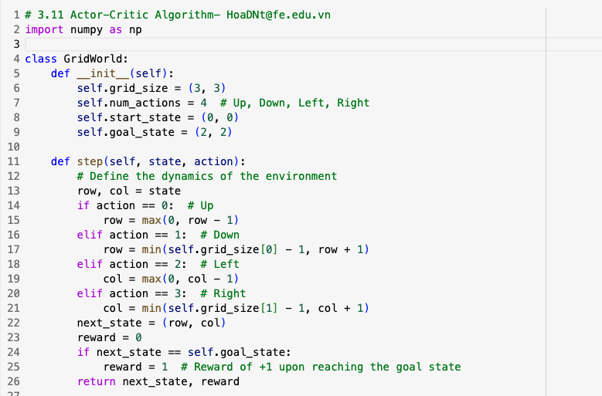
Actor-Critic Algorithm
The Actor-Critic algorithm in a simple grid world environment
Actor-Critic for Continuing Tasks
12
Notes:
12

Slide 13
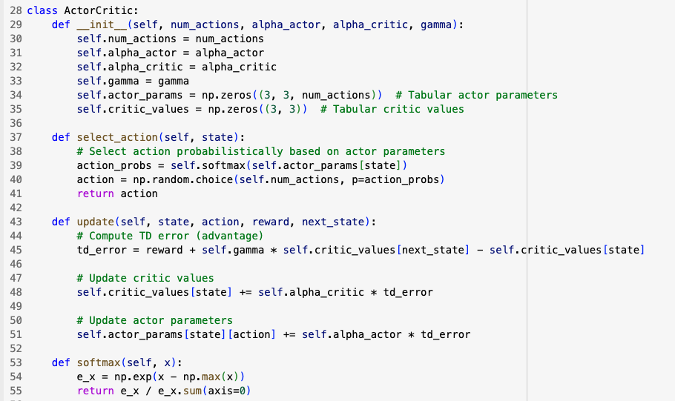
Actor-Critic Algorithm
Actor-Critic for Continuing Tasks
13
Notes:
13

Slide 14
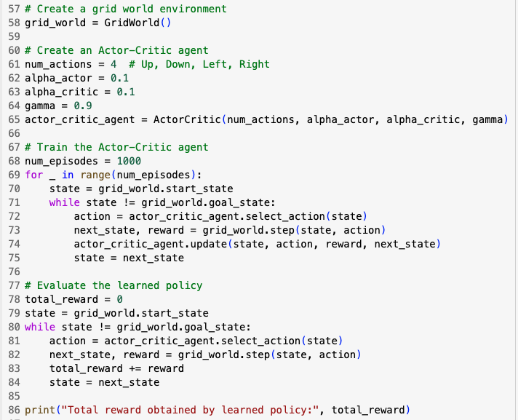
Actor-Critic Algorithm
Actor-Critic for Continuing Tasks
14
Notes:
14

Slide 15
Actor-Critic Algorithm
Run that code and show a total reward obtained by learned policy
Actor-Critic for Continuing Tasks
15
Notes:
15

Slide 16
Summary
Derive a sample-based estimate for the gradient
Understand the Actor-Critic algorithm
Actor-Critic for Continuing Tasks
16

Slide 17
Q & A
Actor-Critic for Continuing Tasks
17

